Slide 1
Analysis of Child Care Services in the Neighborhoods of Edmonton, AB
AbdAllah Elsheikh
February 23, 2020

Slide 2
Introduction
Planning Child care services in a city is very crucial to ensuring sustainable services for families in different communities.
It is also essential to support the children development by ensuring that the child care services are accessible, less crowded, and properly managed.
In this exploratory exercise, I will explore and analyze different neighborhoods in the city of Edmonton, AB, to identify which areas are possibly underserved when it comes to child care.

Slide 3
Data acquisition and cleaning
Data preparation:
Dataset 1: Edmonton City Neighborhoods boundaries data – City of Edmonton, which contains the following columns: Neighborhood, Longitude, and Latitude. To access the dataset, click here.
Dataset 2: Edmonton Population data – City of Edmonton, which contains the following columns: Neighborhood, Population (Age 0-4), Population (Age 5-9), Population (Age 10-14). To access the dataset, click here.
Dataset 3: Child Care Information Dataset - Government of Alberta, which contains the following columns: Type of Program, Program Address, Program City, Postal Code, Neighborhood, Phone Number, Capacity, Accreditation Status. To access the dataset, click here.
Remove duplicates, unnecessary columns, and perform calculations needed for the mapping.

Slide 4
Methodology
Exploratory Analysis:
Explore the children (age 0 to 4) population in each neighborhood.
Explore child care services in each neighborhood – using foursquare maps – returned no results.
Explore child care services in each neighborhood – using the government of Alberta dataset.
Create the maps for the population analysis and for the child care services analysis.
Visually identify clusters of neighborhoods that are underserved and need more attention (potential candidates for child care services business investment).

Slide 5
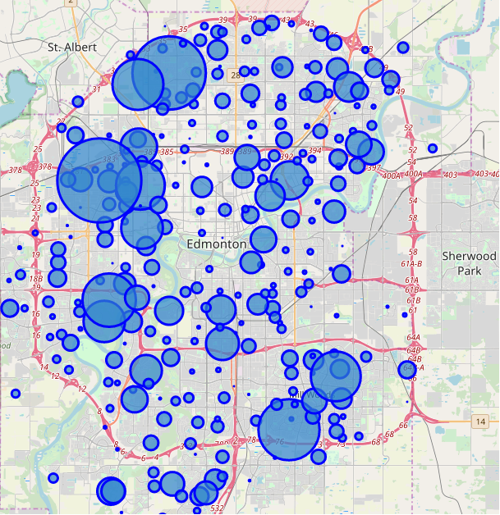
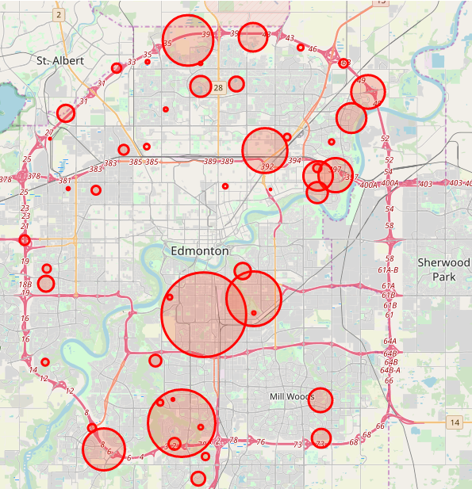
Results & Discussion
We can visually identify clusters of neighborhoods where there is a large children population, especially age 0 to 4, but does not have the capacity in the current daycare business.
Such neighborhoods, mainly in the northwest, the southwest, and the southeast part of the city are good candidates to start a new daycare business.

Slide 6
Conclusions
In this study, I analyzed the child care services in the neighborhoods of the city of Edmonton, AB, in relation to the population of children, age 0 to 4 years old, in order to identify neighborhoods that are underserved or overserved, and to identify future child care business opportunities for investors.
I also tried to highlight the fact that a larger young population means a need for planning other services and family oriented facilities in the area to support healthy living and child development.
In terms of datasets, foursquare maps can improve their database on businesses in Edmonton, AB.

